Slide 1



Integration of multi-omics and signaling datasets into genome-scale metabolic models
Hong Yang
Science for Life Laboratory

Slide 2





Introduction of myself
1990
was born in Gansu Province in China
2009
Bachelor in Bioinformatics
2013
Master in Pharmaceutical Science
2017
Research associate in
Gastroenterology department
2020
PhD student

Slide 3

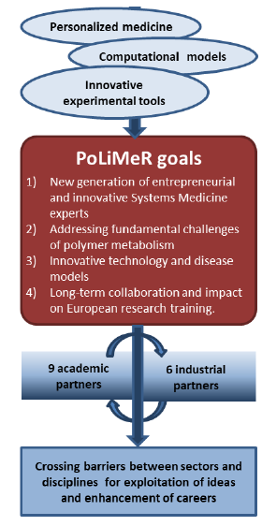
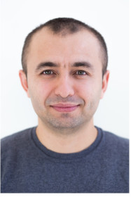

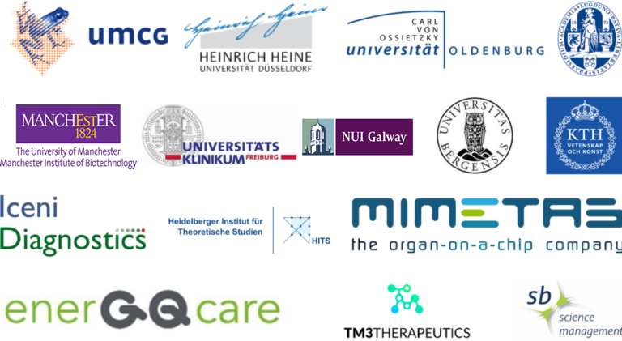

Marie Sklodowska-Curie Actions - ITN
Marie Sklodowska-Curie Actions - ITN
Marie Sklodowska-Curie Actions - ITN
PoLiMeR Polymers in the Liver: Metabolism and Regulation (No 812616)
IEMs Inherited Metabolic Diseases
Supervisors
Dr. Adil Mardinoglu
Dr. Ronan Fleming
15 ESRs

Slide 4
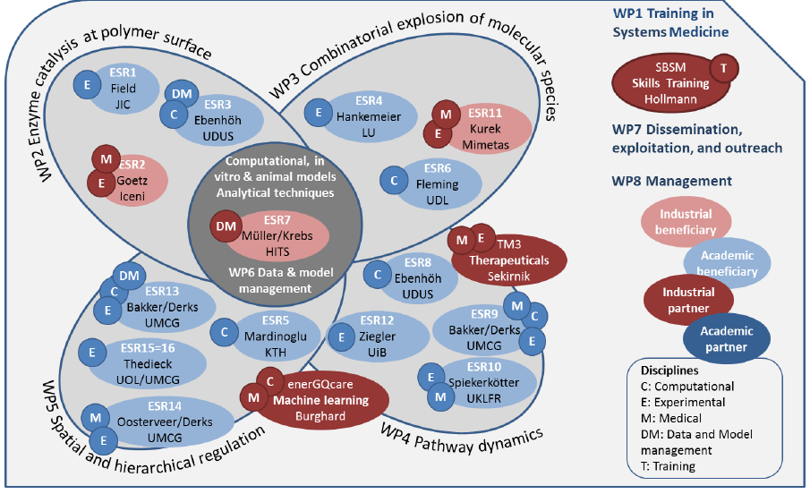
How does PoLiMeR work?
Monogenetic inherited diseases of glycogen and fatty-acid metabolism: hepatic glycogen-storage diseases (GSDs) and mitochondrial fatty-acid oxidation (mFAO) disorders.
Complementary expertise and resources in computational models, experimental models, clinical studies, and analytical tools.
5 + 3 Work packages
5 Research objectives

Slide 5
Glycogen Storage Disorders and mFAO Defects
Maintenance of glucose homeostasis is crucial to meet cellular energy during stress or increased demands.
Glucose is stored as glycogen primarily in the liver and skeletal muscle with a small amount stored in the brain.
Mutations in genes encoding individual enzymes in the glycogen metabolism pathway lead to GSDs.
Mutations in genes involved in mFAO result in mFAO defects.
Symptoms fasting hypoglycaemia ± hepatomegaly;
exercise intolerance; rhabdomyolysis;
fixed muscle weakness; sudden death, et al.
Asymptomatic
?
Kanungo, Shibani, et al. Annals of translational medicine 6.24 (2018).
van Eunen, Karen, et al. BMC biology 14.1 (2016): 1-15.

Slide 6



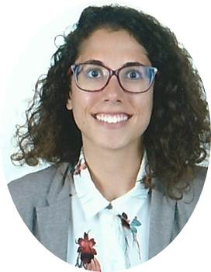
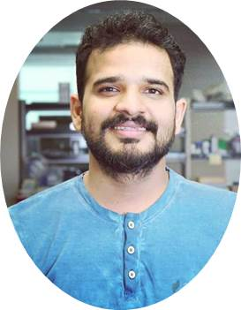
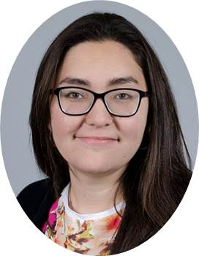
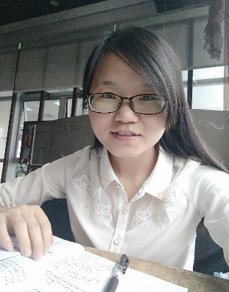
WP5: spatial and hierarchical regulation
To develop novel experimental and computational methodologies to follow polymer in the cell and integrate this spatial regulation with classical levels of regulation.
Maria Rodríguez Peiris
Kishore Alagere Kishnamurthy
Ligia Akemi Kiyuna
Hong Yang
GSD1
In vitro system
Mouse models
Liver slices
MCADD
Mouse models
GEMs
Integration of multi-omics
Understanding the mechanisms of compensatory and design more interventions

Slide 7
Progress of PoLiMeR
Recruitment of ESRs
Flavio Bonanini
Kishore Alagere Krishnamurthy
Siti Nurjansh
Yvan Rousset
Madhulika Singh
Ligia Akemi Kiyuna
Chilperic Armel foko Kuate
Ghadeer Mobasher
Hong Yang
Oct
Jan
Mar
Apr
May
Jun
Jul
Aug
Oct
Jul
Johannes CW Odendaal
Gaia Fancellu
Filothei Tzounidou
Maria Rodriguez Peiris
1 ESR also delayed by coronavirus
1 open position
Kick-off meeting and scientific progress

Slide 8
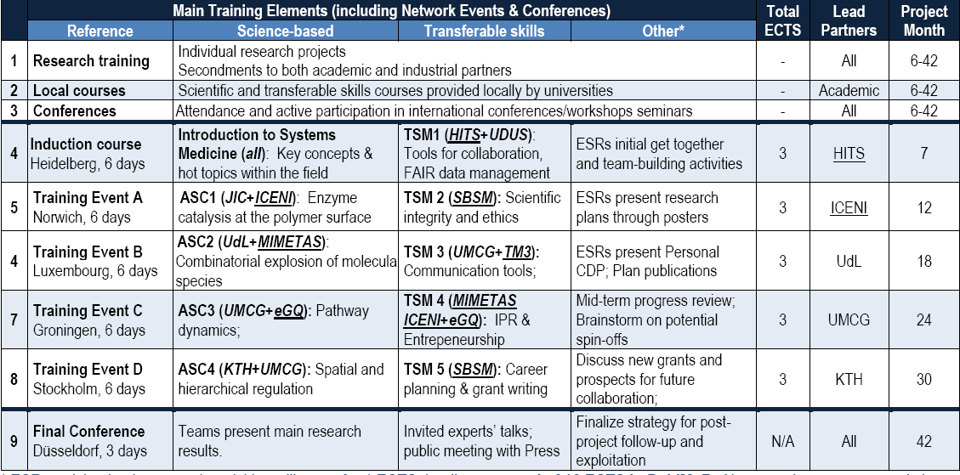



Training, Visiting, and Secondment
Short visiting
(1~2 week)
Secondment
(at least 3 week)

Slide 9


Acknowledgement
Adil Mardinoglu, PhD
Barbara Bakker, PhD
Cheng Zhang, PhD
Ozlem Altay, PhD
Karen van Eunen, PhD
PoLiMeR ESRs:
Ligia Akemi Kiyuna
Kishore Alagere Krishnamurthy
Maria Rodriguez Peiris
Siti Nurjanah

Slide 10
Group Meeting
Literature research for writing a Review paper - ongoing
Collecting omic datasets for modeling - ongoing
Career development plan (PoLiMeR), individual study plan, and general study plan (PhD courses) in ISP system – next step

Slide 11
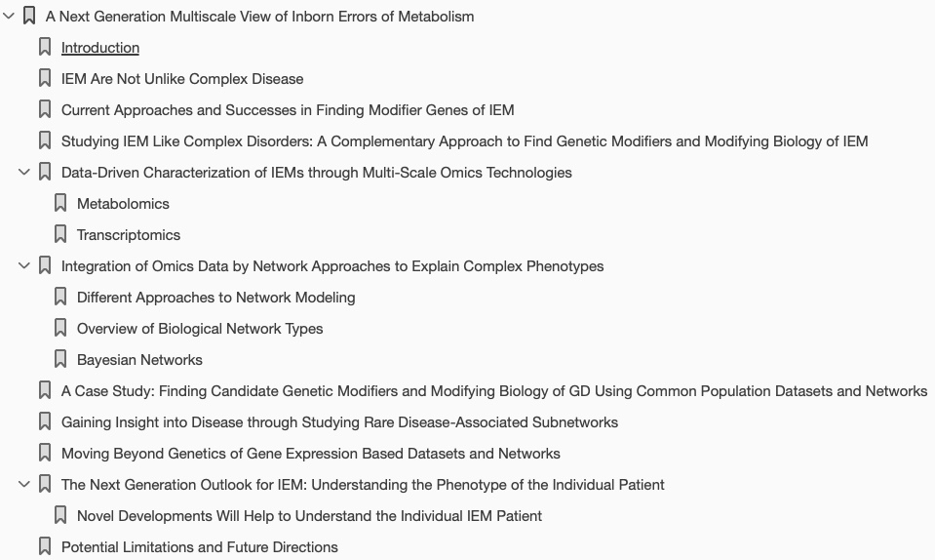
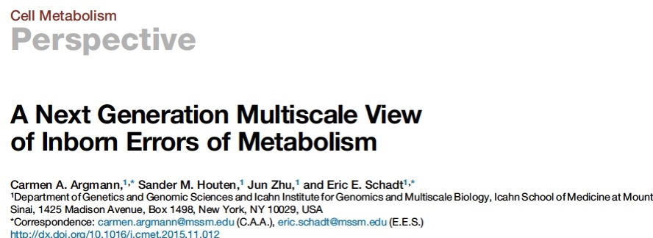
Literature research for writing a Review paper
Glycogen Storage Disease (GSD)
MCADD
……

Slide 12
Omic datasets for modeling
Transcriptomics datasets from MCAD-deficient Mice
GSE136309 (2019); GSE37546 (2012)
Additional datasets generated within PoLiMeR

Slide 13
Project ongoing
Data analysis and visualization
COVID-19 phase 2 study
NAFLD phase 2 study

Slide 14
Figures in main text: 2/6
Tables in main text: 1/1
Tables in supplementary: 2/2
Figures in supplementary: 3/7
Datasets in supplementary: 6/7

